Slide 1
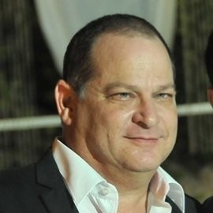
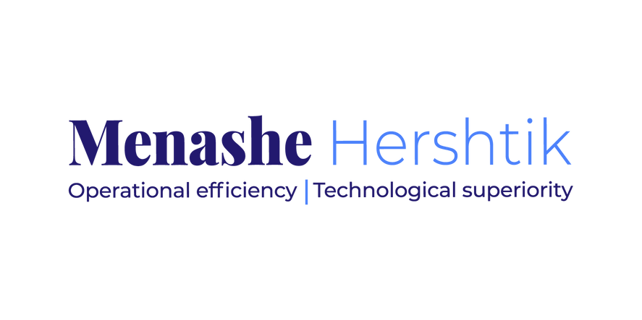
MENASHE HERSHTIK
Business & Enterprise Architecture, Transformation Digital & Innovation Bootcamp

Slide 2
INTRO
For organizations seeking to thrive or just survive in a shifting economic, regulatory, and global business climate, escalating demand for change remains the only constant. External and internal forces are driving business model realignment, digital transformation, and a myriad of innovation

Slide 3
INTRO
Companies are pursuing a combination of transformational strategies while concurrently having to manage risk, prepare for crises, and improve the bottom line. In almost all cases, strategic challenges are complicated by operating models comprised of redundant, opaque processes; fragmented and highly intertwined IT architectures; and entrenched personnel alignments. As a result, most organizations can add operating model optimization to their list of plans.

Slide 4
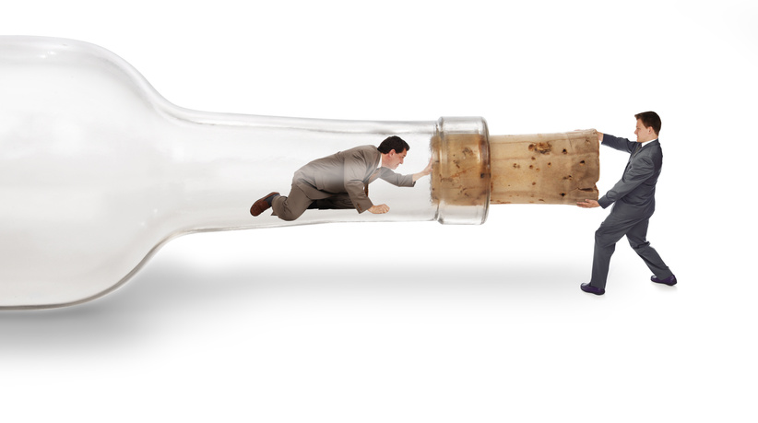
The Process
vision
scrum
targeting
planning
action

Slide 5
IT +DATA+TECHNOLOGIES+ PROCESES

Slide 6
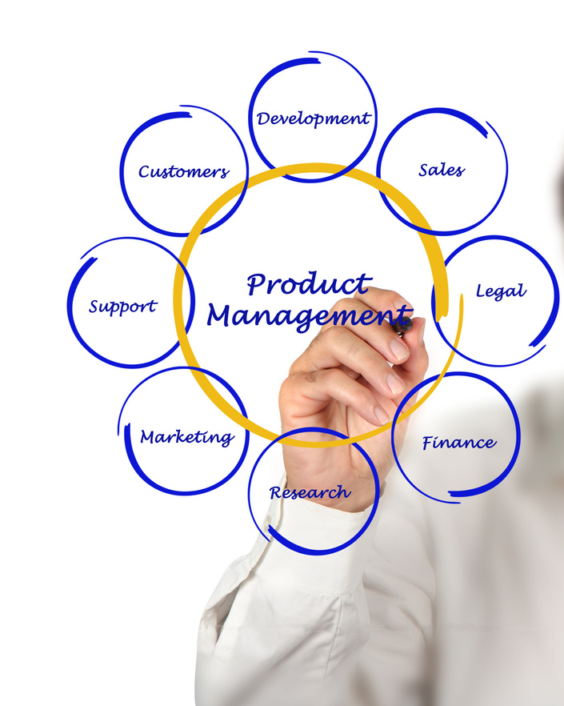
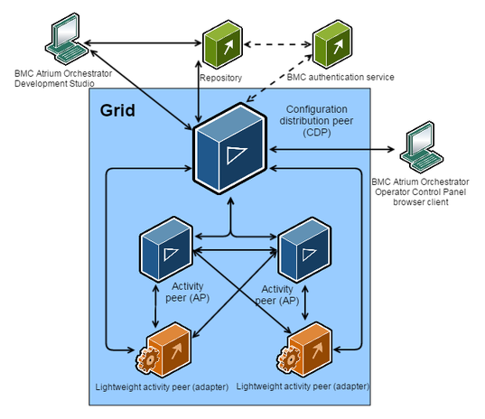
The Idea Journey
IT Architecture
IT Transformation
Product Managment

Slide 7
What can a business do in the face of these challenges?

Slide 8
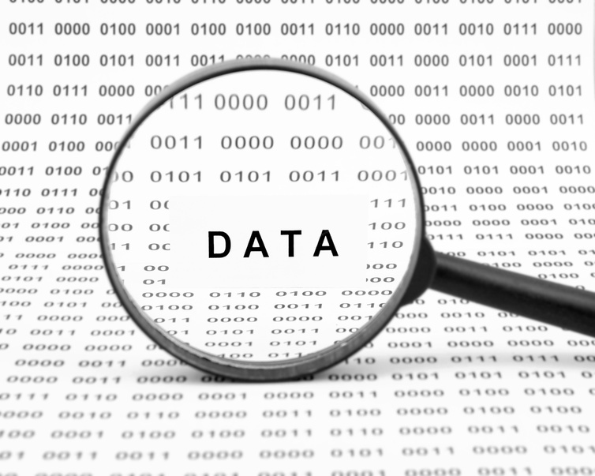
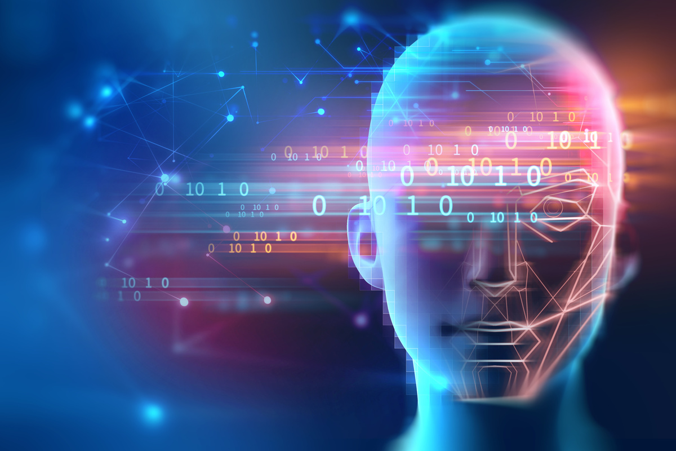
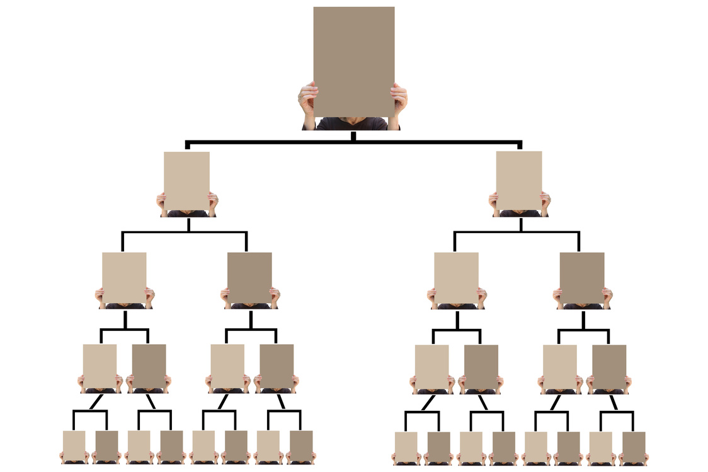
Focus Points
Buisnes Process
DATA
Technology
Rolls & Responsibilities

